Slide 1

Weather app for Makers Valley
By Group 28

Slide 2
Presentation Overview:
Introduction to problem/solution (Benedict/Jakub)
UML Diagram (Benedict)
Requirements and Stakeholders (Oliver)
Stakeholders and Empathy Map (Oliver)
Personas (Charlie)
Use Case List (Muhammed)
Use Case Diagram (Muhammad)
Textual use case description (Jakub)
Lofi Design (Muhammad)
Suitability (Charlie)
User Testing (Benedict)
Tools and Libraries Used (Jakub)
Gantt Chart (Muhammad)
Conclusion (Jakub)

Slide 3
Introduction to our problem
A lack of information could lead the locals to make Un optimal decisions in sectors like agriculture leading to lower food availability provided by local businesses.
Inconsistent internet access due to power shedding
prevents locals from knowing what the weather will be like for the next couple days.
Load shedding often lasts 10-14hr.
Each household only has 2 phones with usually 1 of them being higher quality with 4g capabilities
Few people have computers
Floods are common
Power outages are common and can last 10-14hrs

Slide 4
Introduction of our solution
We have made an app which allows residents of Makers Valley to access the weather even if power and the internet is down.
Mission Statement - "We are committed to making a lightweight weather app for users in Johannesburg and other locations"

Slide 5
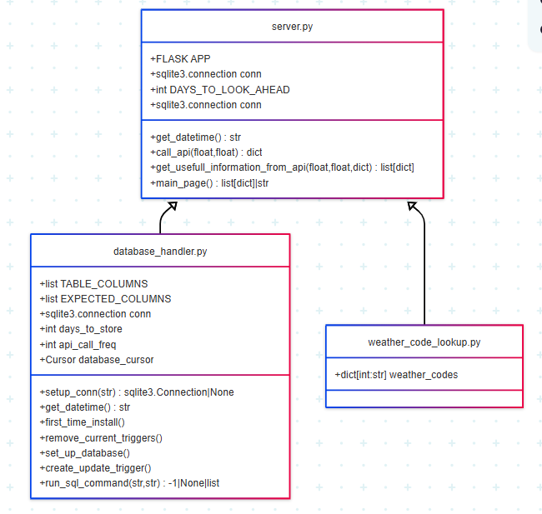
UML Diagram

Slide 6
Requirements: (With MoSCoW Analysis)
Manual/Automatic refresh when internet is available (Could)
Light and dark mode (Could)
Be able to accommodate multiple languages (Could)
Log-in system (Won't)
Real-time radar (Won't)
Allow the user to customise what metrics they want (Won't)
Accurately displays weather for correct region (Must)
Simple GUI (Must)
Being able to download information (Should)
Detects if a flood is possible in the week (Could)
Notifies the user that a flood is possible (Could)
Allow user to change units to suit their needs (Could)
Alerts user to upcoming power outages (Could)
Alerts user of other disasters (e.g. Heatwave) (Could)

Slide 7
Stakeholders:
Empathy Map:
Users (Local community, businesses, farmers
Developers
Open-Meteo Weather API
User | Farmer
Says | I wonder if it's going to rain later
Thinks | I would be able to make better decisions with a weather app that doesn't rely on constant internet access.
Does | Make decisions based on the weather.
Feels | Frustrated when the internet is down and he needs to look at the weather
Notes:
(Make personas for as many stakeholders as we can, include the rest at the bottom as others to consider.)

Slide 8
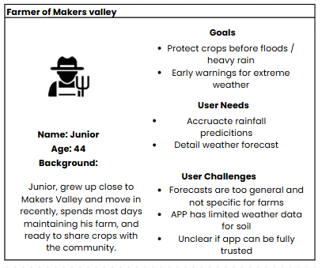
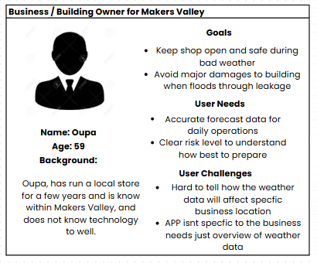
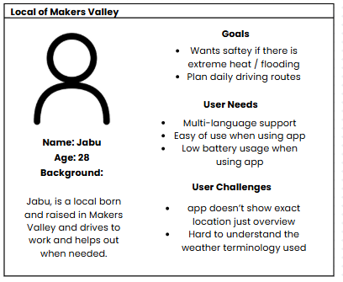
Personas

Slide 9
Use Case List
ID | Use Case | Primary | Complexity | Priority
1 | Download raw weather data | User | High | 1
2 | Input current location | User | Medium | 4
3 | upload data | User | Medium | 1
4 | Switch between light and dark mode | User | Low | 5
5 | Switch between units | User | Low | 5

Slide 10
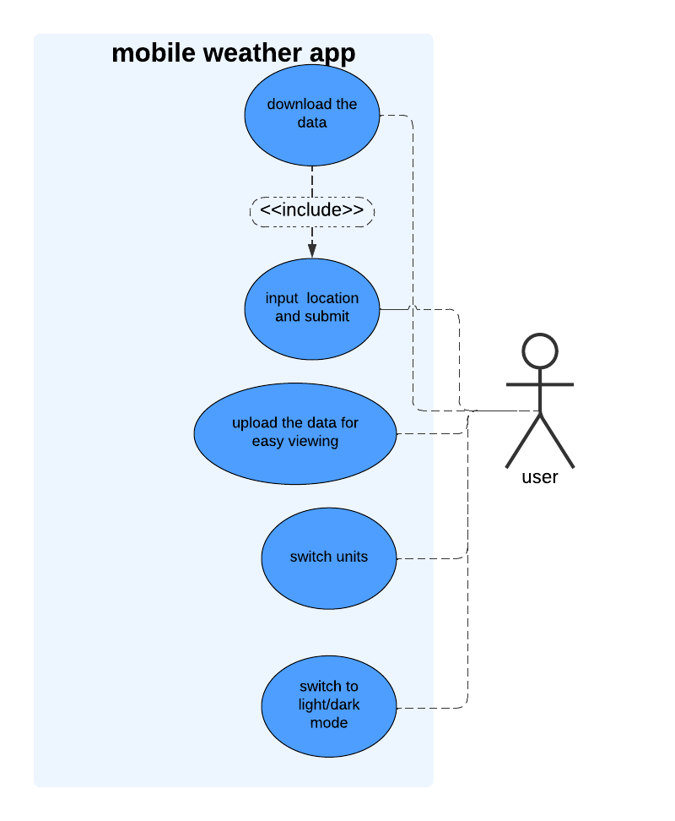
Use case diagram

Slide 11
Textual Use Case Description
Name | Download the data
Goal | Download one week’s worth of weather data
Summary | The user should be able to download one week’s worth of weather data as a file so they are able to view the weather for the next week.
Actors | User
Stakeholders | N/A
Preconditions | Server must be running User must be connected to the internet
Trigger | User inputs location data
Happy Path | User inputs location data Server checks database for data on user’s input Server sends weather data to the client Client displays weather data User presses button to download weather data
Unhappy path(s) | User inputs location data Server not responding Error is shown on user’s screen
 | User inputs location data Server requests data from database Database not responsive Error is shown to user
Post conditions | User has 1 week’s worth of weather data, and data is displayed on screen.

Slide 12
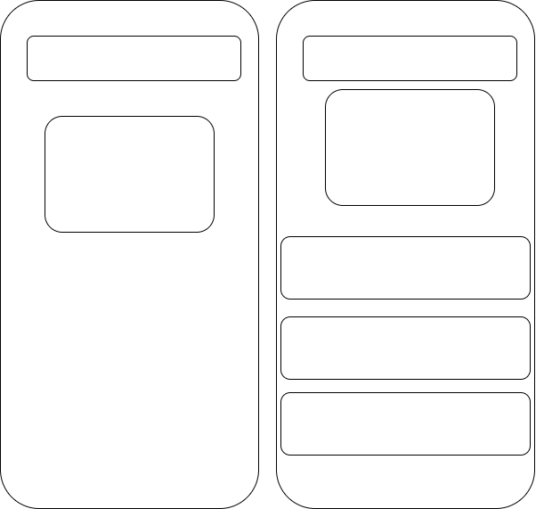
Lofi design

Slide 13
Relevance - Suitability
Does the software answer the problem?
Region-appropriate?
Environmental
Legal & Ethical Suitability
Scalability
Notes:
---------------------------
Software answer the problem
---------------------------
Our application will help the locals of Makers Valley prepare for floods, heats, since it helps provide a weekly forecast, this helps in locals preparing for safe routes to get around, and protects crops and will help reduce waste contamination.
------------------
Region Appropriate
------------------
The weather API covers Makers Valley, and the app supports multiple local languages that are common, The app addresses the flood risks that are specific to this region of Johannesburg, Since floodings have had a major impact to farmland, buildings and the contamination of the river and street's.
-------------
Environmental
-------------
We ensure our app is suitable for Makers Valley environment, which faces floodings, and extreme heats, since we give insight to help reduce trash pollution in the local river, and help support buildings with poor materials, and farmers to give them early warnings to protect their farmland from flood contamination.
---------------------------
Legal & Ethical suitability
---------------------------
Our app will follow the South African Weather Service Act 8 of 2001, which bans false weather alerts. We get our API data from Open-Meteo which requires users to accept their terms before using the app to ensure compliance otherwise it can lead to penalties.
-----------
Scalability
-----------
The app scales easily for Makers Valleys and beyond for other locations. This the API we use is cost effective and flexible for different regions, also it allows for highly specific weather data to be chosen.

Slide 14
Accessibility & Local - Suitability
Power-outages
Energy Suitability
Software requirements
Technical experience needed
Ease of use
Notes:
-------------
Power-outages
-------------
Makers Valley faces frequent load shedding, often lasting 1-10 hours. Since their internet access isn't reliable our application allows users to locally store a week's worth of weather data on their device.
--------------------------------------------
Energy Suitability
--------------------------------------------
Our application suits Makers Valley's energy limits, since they have load shedding which affects many local's homes, our appl runes on an older phone, and the app automatically sets as dark mode to aid in power saving.
---------------------
Software requirements
---------------------
our weather application is designed to run on an older phone while using as little energy as needed, So locals can access it when internet is available when load shedding is done. The app is open-source, so users can install it locally and even customize the weather data to their needs whether their a farmer or a resident.
---------------------------
Technical experience needed
---------------------------
Our app will need some basic tech skills to use, since it will need to be downloaded for an app store, and they will also need to find the stored weather data, however Makers Valley has various schools such as a digital literacy workshop where locals can get support.
-----------
Ease of Use
-----------
The app, is simple to use, since it has a clear interface, and a set dark mode for power saving, the app is designed for the Makers Valley local community, so it has easy navigation and supporting the common diverse languages.

Slide 15
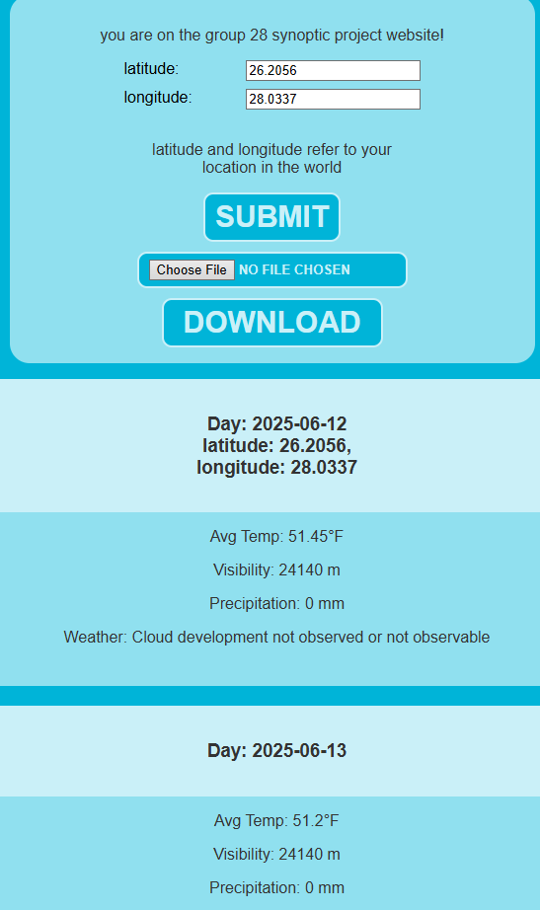
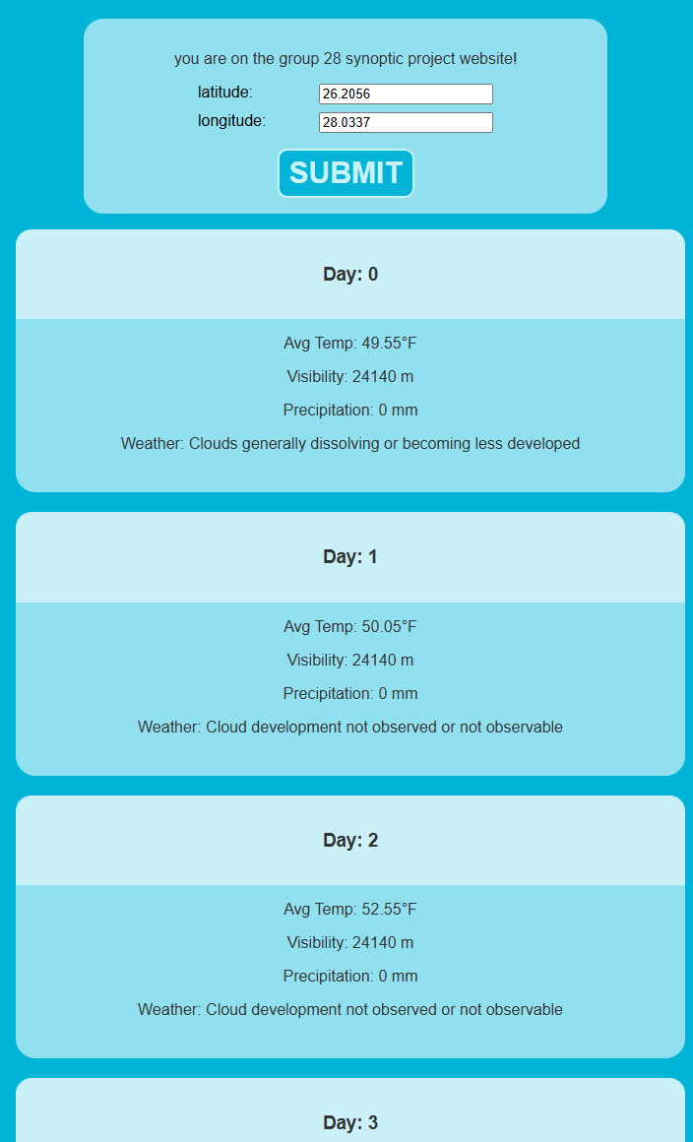
User Testing
Before feedback after feedback:

Slide 16
Tools and Libraries used
Open-Meteo Weather API – For the server to get the weather report on a location to be saved and sent to clients.
Sqlite3 - For handling a database to store the most recent API response.
Flask – To handle setting up the localhost website and user traffic.
Datetime – For timestamping users.

Slide 17
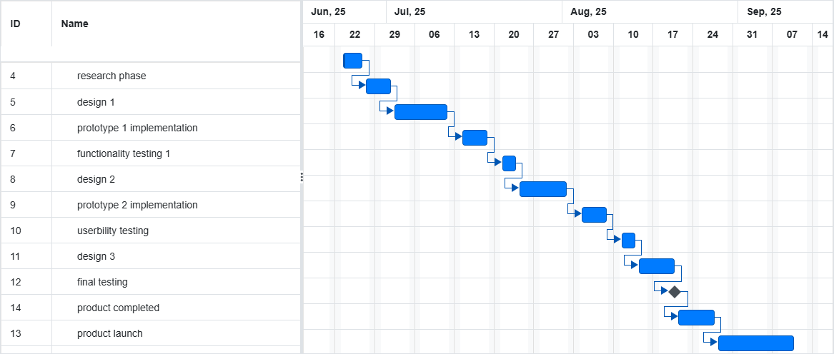
Gantt chart

Slide 18
Conclusion
THE. end

